Slide 1
Echoes of pandemic

Slide 2
Table of Contents
Objective and motivation
Human Development Index and its trajectory
Changes in GDP before, during and after pandemic
Correlation analysis between GDP growth & HDI
Trend in Unemployment
Correlation analysis between Unemployment rate & HDI
Human Freedom Index, its trajectory & correlation

Slide 3
The Covid-19 pandemic has had a profound impact on the global economy and humanity.
This capstone project aims to analyze these impacts to uncover trends and potential patterns that emerged during the pandemic.
By leveraging data analytics, this project seeks to provide insights into how different economies responded to the crisis and their subsequent recovery trajectories.
As a data analyst with a keen interest in macroeconomic trends and policymaking, I’m always striving to gain a better understanding of economic trends and indicators. Today we will observe how this pandemic has reshaped the global economic landscape and overall quality of daily life.
.

Slide 4
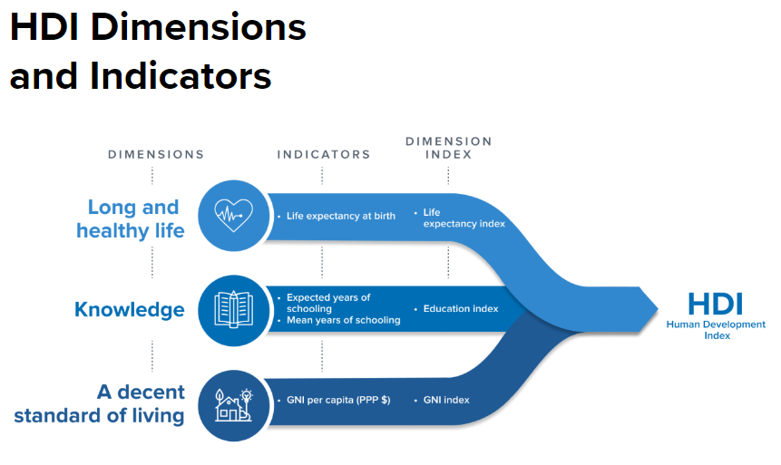
Human Development Index
HDI is a composite measure of a country's average achievements in three basic aspects of human development: Health, Knowledge and Standard of living.
The HDI serves as a crucial tool for policymakers, researchers, and international organizations to compare development levels across countries, identify areas needing improvement, and track progress over time.
** https://hdr.undp.org/data-center/human-development-index#/indicies/HDI

Slide 5
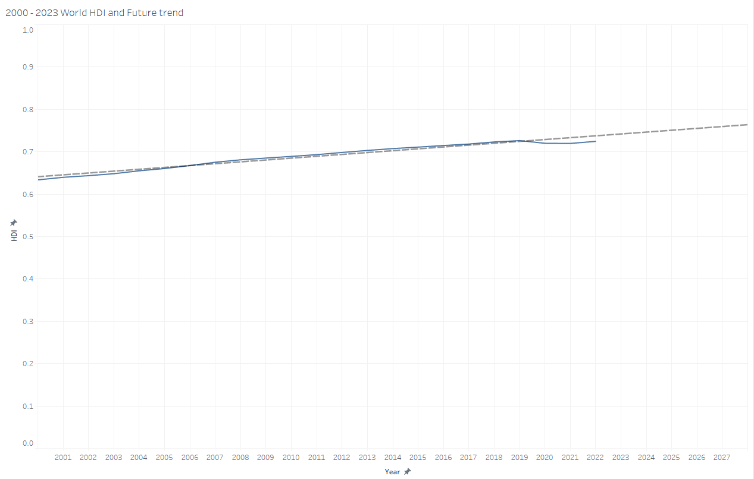
Trajectory of Human Development Index
This chart shows a concerning impact of the pandemic on global development.
By comparing the current HDI level to that of approximately 2016-17, we can observe that the overall quality and satisfaction of life have regressed, largely due to the disruptions caused by the pandemic.
This setback indicates that the progress made in the years leading up to 2020 has been diminished, effectively ‘putting us behind’ by few years.
The world may take time to return to the pre-pandemic trajectory, as the factors contributing to HDI, were all affected by the global crisis.

Slide 6
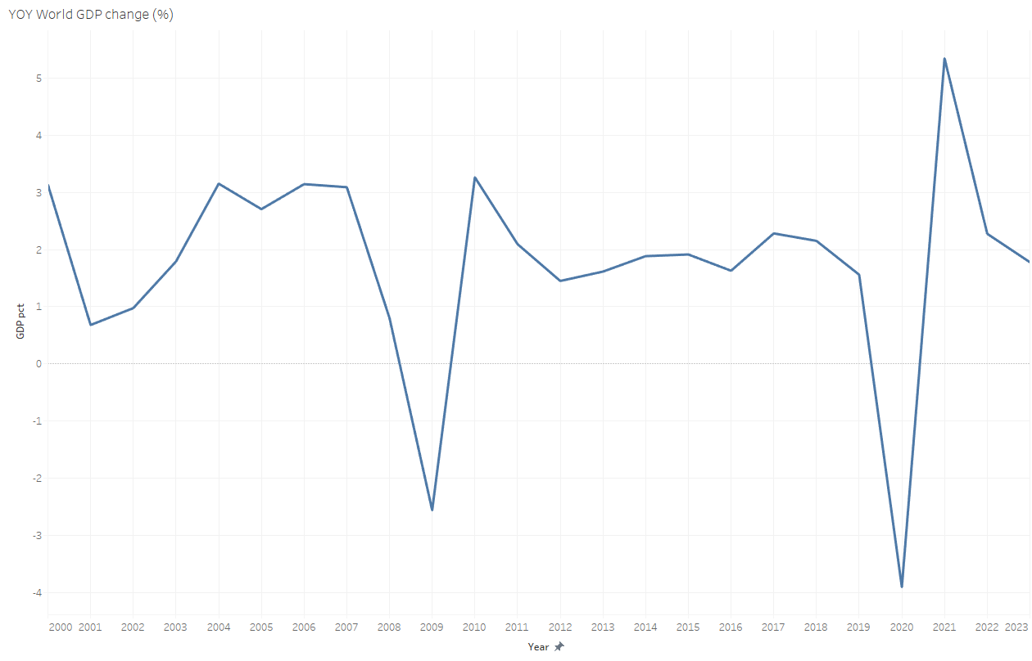
Changes in GDP before, during & after
GDP growth trajectory over the past two decades has been notably impacted by two major events:
The great recession (2008-09)
The COVID-19 pandemic (2020-23)
Both caused significant disruptions to global GDP growth however, the rapid recovery in both instances illustrates the resilience of the global economy.
The importance of timely and coordinated interventions to support economic stability allowed to navigate through challenges like travel restrictions which have had a severe impact on:
global supply chain
consumer spending
leisure & business travel

Slide 7
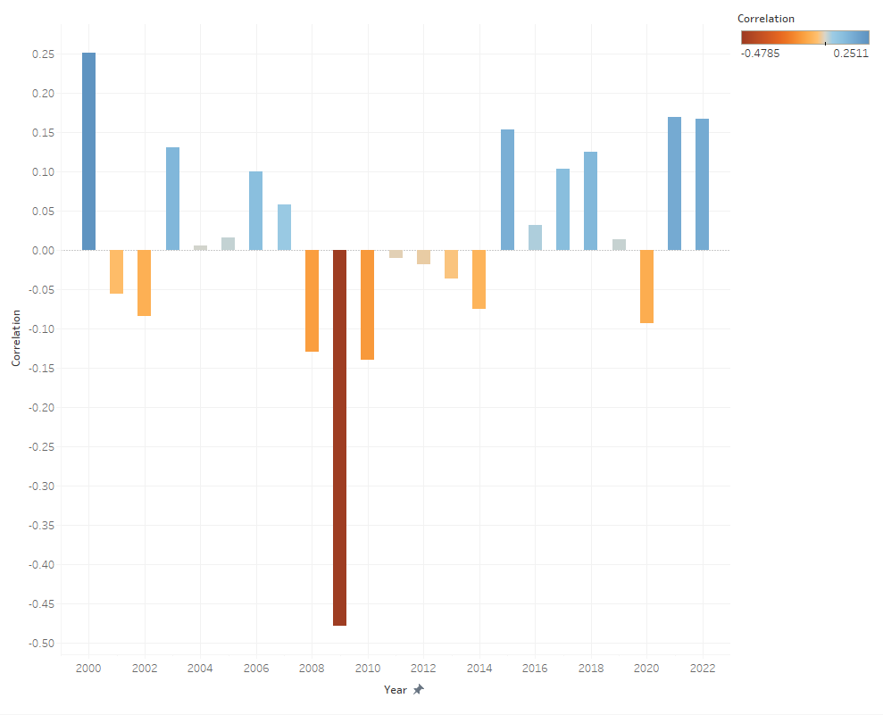
YOY Correlation between Changes in GDP and HDI across the world
Positive correlation is observed for years 2021 & 2022 suggests that as economies started to recover from the initial shock of the pandemic, there was a corresponding improvement/stabilizing in the overall quality of life.
Negative correlation is evident during the years of recession, indicating that despite the economic downturn, the overall quality of life did not deteriorate to the same extent.
Also, negative correlation is observed in 2020, likely due to the timing of data evaluation. The discrepancy may also be influenced by the fact that economic indicators and human development assessments may have been captured at different stages of the pandemic’s progression.

Slide 8
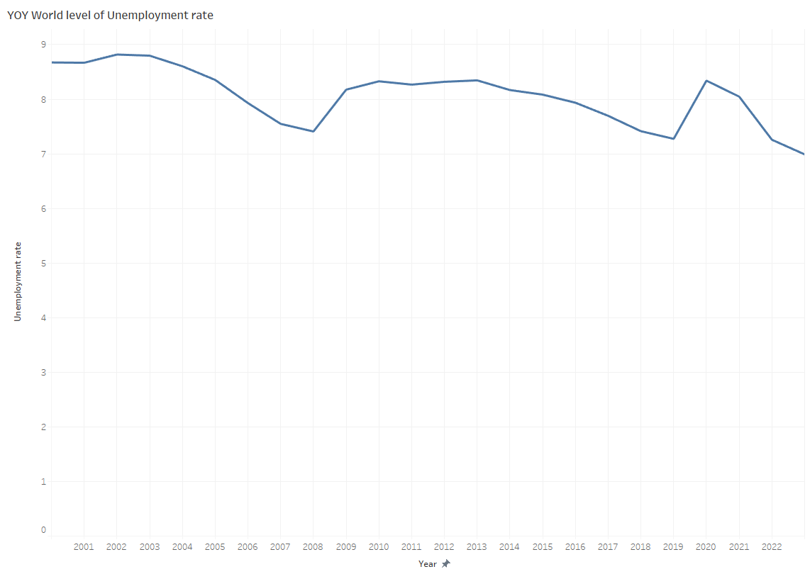
Trend in unemployment
Similar to the trend observed in GDP growth, Unemployment rates worldwide were significantly impacted by both, the recession and the pandemic.
Pre-event levels appear on par and the occurred increases/recovery can also be measured in the same volume.
These observations highlight the deep intertwining between economic activity and employment, emphasizing the need for proactive measures to protect jobs during economic downturns to ensure previously observed robust recovery of GDP after all.

Slide 9
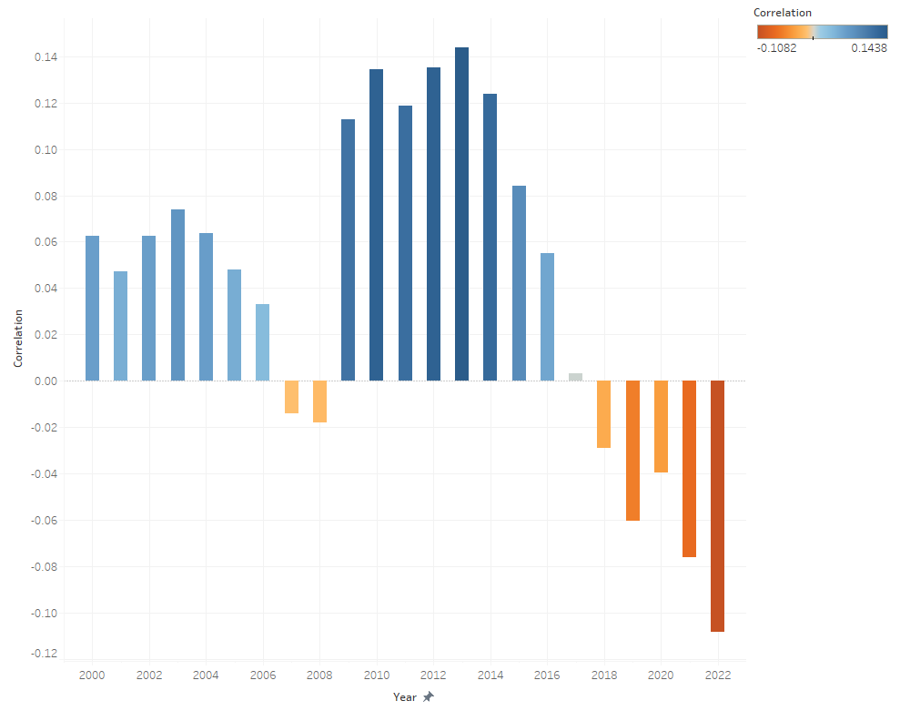
YOY Correlation between Unemployment rate and HDI across the world
Negative correlation is observed between 2018 and 2022 indicating a weak inverse relationship between the variables.
Positive correlation is observed post the recession showing that both indexes were moving in the same direction. This suggests that economic recovery and improvements in HDI were closely linked. As economies recovered, employment levels improved, leading to better overall living standards which positively impacted HDI.
During the recession negative correlation index was even more insignificant suggesting that there is even weaker relation between Unemployment and HDI.
Overall observations reflect the complex dynamics between economic indicators like Unemployment and broader measures of human development, emphasizing the need to consider multiple factors when analyzing such relationships.

Slide 10

Human Freedom Index
HFI presents the state of human freedom in the following areas:
Rule of law
Security and safety
Movement
Religion
Association, assembly, and civil society
Expression and information
Relationships
Size of government
Legal system and property rights
Sound money
Freedom to trade internationally
Regulatory Environment
HFI provides a comprehensive overview of how well different countries protect and promote individuals' freedoms. By examining these dimensions, the index offers insights into the varying degrees of human freedom globally and highlights areas where improvements may be needed.

Slide 11
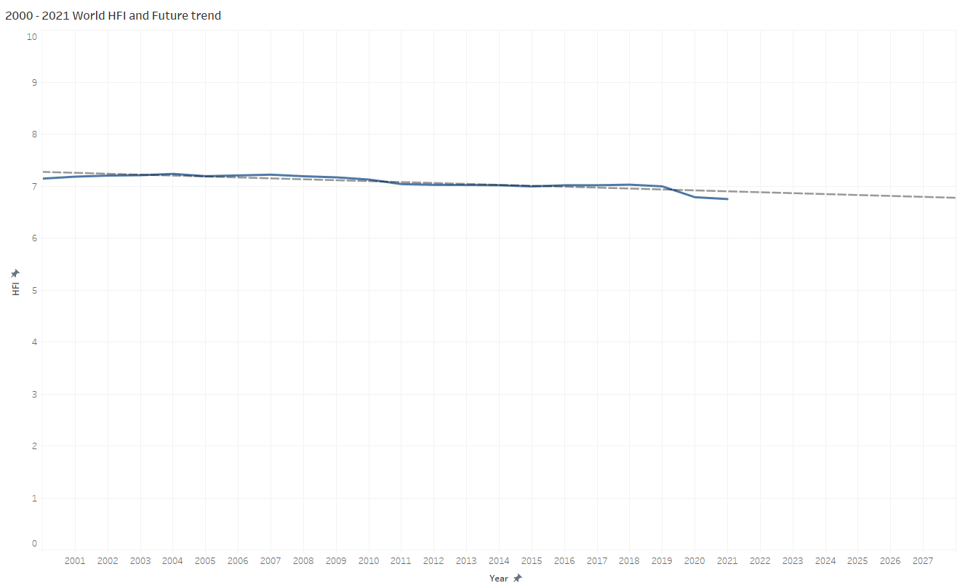
Trajectory of Human Freedom Index
HFI is currently at its lowest historical level.
The decline has begun ~2010-11 and remained relatively flat until a slight increase observed just before the pandemic 2018-19.
However, with the official declaration of the pandemic in 2020, the HFI’s trajectory has ‘dipped’.
This chart suggests a continued downward trajectory over the coming years.

Slide 12
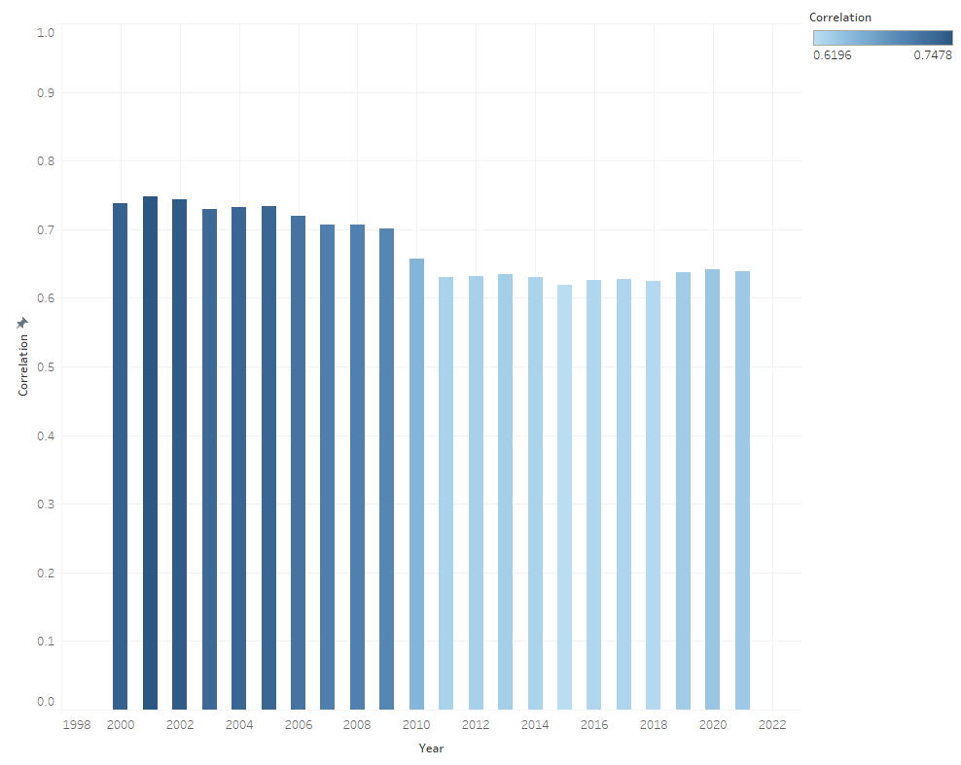
YOY Correlation between HFI and HDI across the world
Additionally, there is a strong correlation between the HDI and HFI suggesting that both indexes have generally moved in the same direction since data collection began in 2000.
Since ~2010-11, there correlation coefficient has experienced a slight decline, yet the relation between these two variables remains relatively stable overall.

Slide 13
conclusions
The observed trends of economic and social indexes showed that pandemic has impacted overall quality of life however this impact is generally considered ‘mild’ as calculated correlation suggests.
Some countries have experienced more severe effects due to additional factors, such as political developments, which have had a more pronounced influence on their economies and daily lives.
While economic factors like GDP growth and Employment are significant elements of how we go about our day-to-day, social and political aspects have had a more substantial effect on overall quality of life.
In this context, the HFI serves as a critical social evaluation tool, complementing the economic measures to provide a more comprehensive view of human well-being.

Slide 14
Thank you for your attention today! aLL questions are welcomed

